Slide 1

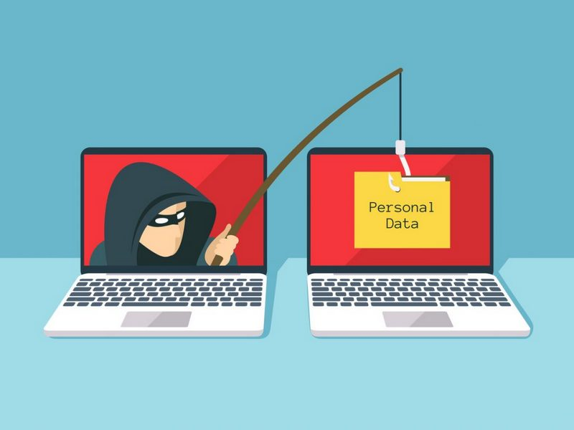
Understanding Phishing Attacks

Slide 2
Agenda
Definition of phishing
Importance of awareness
Objectives of the training:
Recognize phishing attempts
Avoid falling victim to phishing scams
Report phishing incidents
Reference

Slide 3
What is Phishing?
Explanation of phishing:
A cyber attack method where attackers disguise themselves as legitimate entities to steal sensitive information
Common targets: login credentials, credit card numbers, personal information
Examples of phishing: email, SMS (smishing), phone calls (vishing)

Slide 4
Types of Phishing Attacks
Email Phishing:
Mass-distributed fraudulent emails
Characteristics: generic greetings, urgent language, suspicious links
Spear Phishing:
Targeted attacks on specific individuals or organizations
Characteristics: personalized content, appears to come from trusted sources
Whaling:
Targeting high-profile individuals like executives
Characteristics: highly customized and sophisticated
Clone Phishing:

Slide 5
Types of Phishing Attacks
Duplicating legitimate emails and altering links/attachments
Website Phishing:
Fake websites mimicking legitimate ones to steal credentials

Slide 6
Recognizing Phishing Emails
Common signs of phishing emails:
Misspellings and grammatical errors
Unusual sender email addresses
Mismatched URLs
Requests for personal information
Unsolicited attachments
Examples with visuals:
Screenshot of a typical phishing email
Highlight suspicious elements

Slide 7
Avoiding Phishing Scams
Email Precautions:
Don’t click on links or download attachments from unknown sources
Verify the sender’s email address
Hover over links to check URL before clicking
Website Precautions:
Check for HTTPS in the URL
Look for security indicators like a padlock symbol
Avoid entering sensitive information on suspicious websites
General Tips:
Use multi-factor authentication
Keep software and antivirus up to date
Regularly change passwords and use strong passwords

Slide 8
Social Engineering Tactics
Definition of social engineering:
Manipulating individuals into divulging confidential information
Common tactics:
Pretexting: Creating a fabricated scenario to steal information
Baiting: Offering something enticing to get victims to install malware
Quid pro quo: Offering a service in exchange for information
Tailgating: Following someone into a restricted area
Real-life examples:
Stories of successful social engineering attacks

Slide 9
Reporting Phishing Attempts
Importance of reporting phishing
How to report phishing:
Internal process: IT department, security team
External: Report to email providers, government authorities
What information to include in reports:
The suspicious email/website
Any interaction you had
Screenshots, if possible

Slide 10
Case Studies and Interactive Exercises
Case studies of phishing attacks:
Analyze how the attack was carried out
Lessons learned from each case
Interactive exercises:
Identifying phishing emails from examples
Simulated phishing scenarios

Slide 11
Best Practices and Resources
Summary of best practices:
Stay vigilant and cautious
Verify sources before sharing information
Use security tools and features
Resources for further learning:
Links to online courses, articles, and tools
Company’s security policy and guidelines

Slide 12
Q&A and Feedback

Slide 13


Reference

Slide 14
Thank you

